Slide 1
Introduction to machine learning
Data Preparation and Feature Engineering
R. Brooks

Slide 2
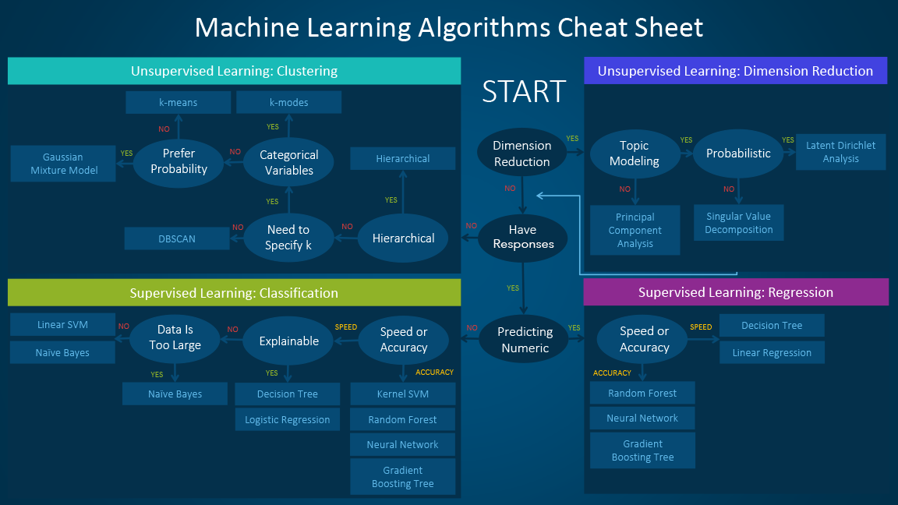

Slide 3
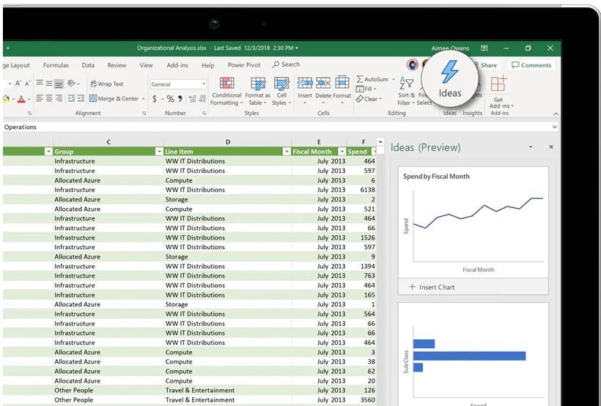




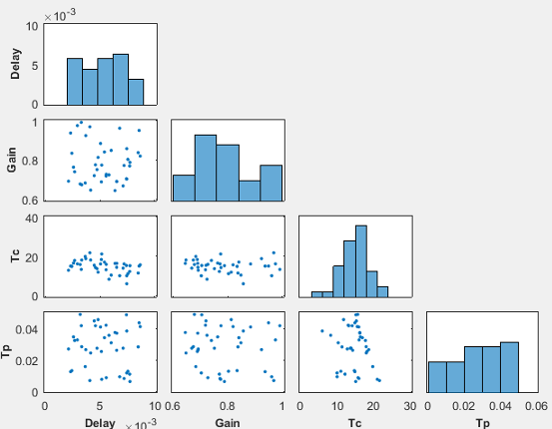
Data Preparation: Exploration & Quality Assessment
Data preparation can take up most of the time of ML project
Explore dataset and look at single examples
Get descriptive statistics (e.g., number of samples, class imbalance, mean, variance, etc.)
Visualize dataset (can also be done using unsupervised ML methods for high- dimensional data)
Assess data quality (missing data, input errors, outliers, etc.)
Data Preparation
Exploration
Quality assessment
Cleansing
Labeling
Imputation
Feature engineering

Slide 4













Process Model for ML
Test data
Model requirements
Metrics
Raw data
Training data
Predictions
Trained model
Requirements
Data
Data
Predictive
Evaluation
Deployment
Analysis
Acquisition
Preparation
Modelling
Icons made by Smashicons from www.flaticon.com
Business metrics
Acceptance criteria
Data protection
Ethics
Interpretability requirements
Exploration
Quality assessment
Cleansing
Labeling
Imputation
Feature engineering
Algorithm selection
Feature selection
Model training
Hyperparameter tuning
Model selection
Evaluation Metrics
Inspection
Interpretation
Manual evaluation
Model compression
Model versioning
Process integration
Monitoring
Online learning
Data collection
ETL
Data integration
De-identification
Feedback
Roles
Data Scientist
Domain Expert
(Data) Engineer

Slide 5






Data Preparation
Data Preparation
Test data
Exploration
Quality assessment
Cleansing
Labeling
Imputation
Feature engineering
Model requirements
Training data
Raw data
Requirements Analysis
Data Acquisition
Data Preparation
Predictive Modeling
Evaluation
Deployment
Roles
Data Scientist
Domain Expert
(Data) Engineer
Icons made by Smashicons from www.flaticon.com

Slide 6
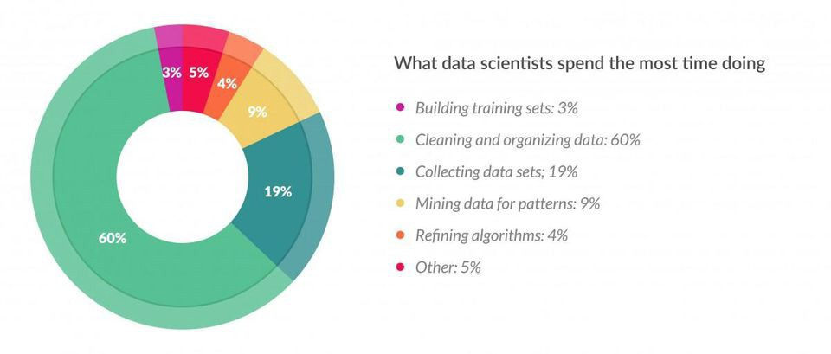
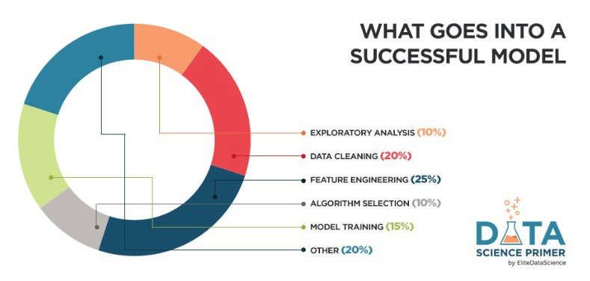
Data Preparation: Importance, Motivation
Data is sparse and incomplete
Preparing the proper input dataset, compatible with the machine learning algorithm requirements
Integral step in Machine Learning
Directly affects the ability of our model to learn
Make sure that it is in a useful scale, format and even that meaningful features are included
Improving the performance of machine learning models
Source: https://www.forbes.com/sites/gilpress/2016/03/23/data-preparation-most-time-consuming-least- enjoyable-data-science-task-survey-says/
https://elitedatascience.com/feature-engineering

Slide 7
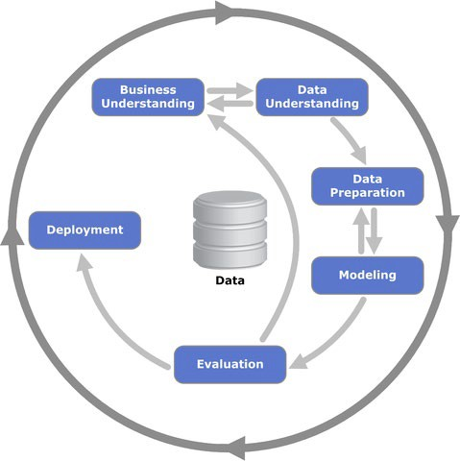
Data Preparation Process
Process for getting data ready for a machine learning algorithm can be summarized
¡ Step 1: Select Data
¡ Step 2: Preprocess Data
¡ Step 3: Transform Data
Follow this process in a linear manner
https://statistik- dresden.de/archives/1128

Slide 8
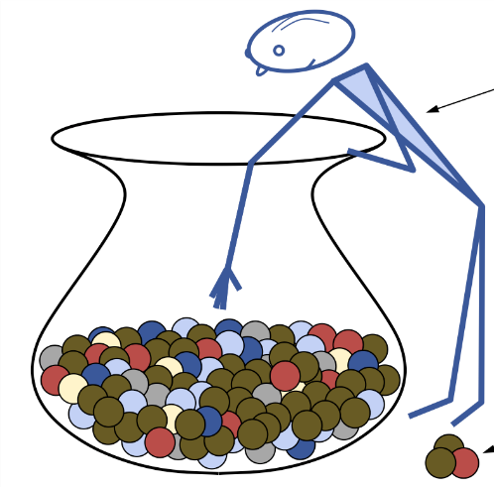
Select Data
Step 1: Select Data
Step 2: Preprocess Data Step 3: Transform Data
There is always a strong desire for including all data that is available, that the maxim “more is better” will hold. This may or may not be true
Consider what data you actually need to address the question or problem you are working on
Questions to help you think:
¡ What is the extent of the data you have available?
¡ What data is not available that you wish you had available?
¡ What data don’t you need to address the problem?
http://uniquerecall.com/

Slide 9
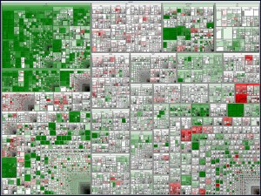
Preprocess Data
Better Data > Fancier Algorithms
Step 1: Select Data Step 2: Preprocess Data Step 3: Transform Data
Formatting: Selected data may not be in a suitable format Cleaning: Removal or fixing of missing data
¡ Incomplete and do not carry the data to address the problem
¡ Sensitive information → anonymized or removed
¡ Identifying incomplete, incorrect, inaccurate, irrelevant parts of the data
Sampling: More selected data available than needed
¡ Longer running times for algorithms
¡ Larger computational and memory requirements
¡ Take smaller representative sample before considering the whole
https://www.flickr.com/photos/marc_smith/1473557291/siz es/l/
dataset

Slide 10
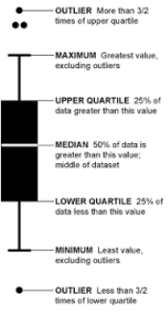
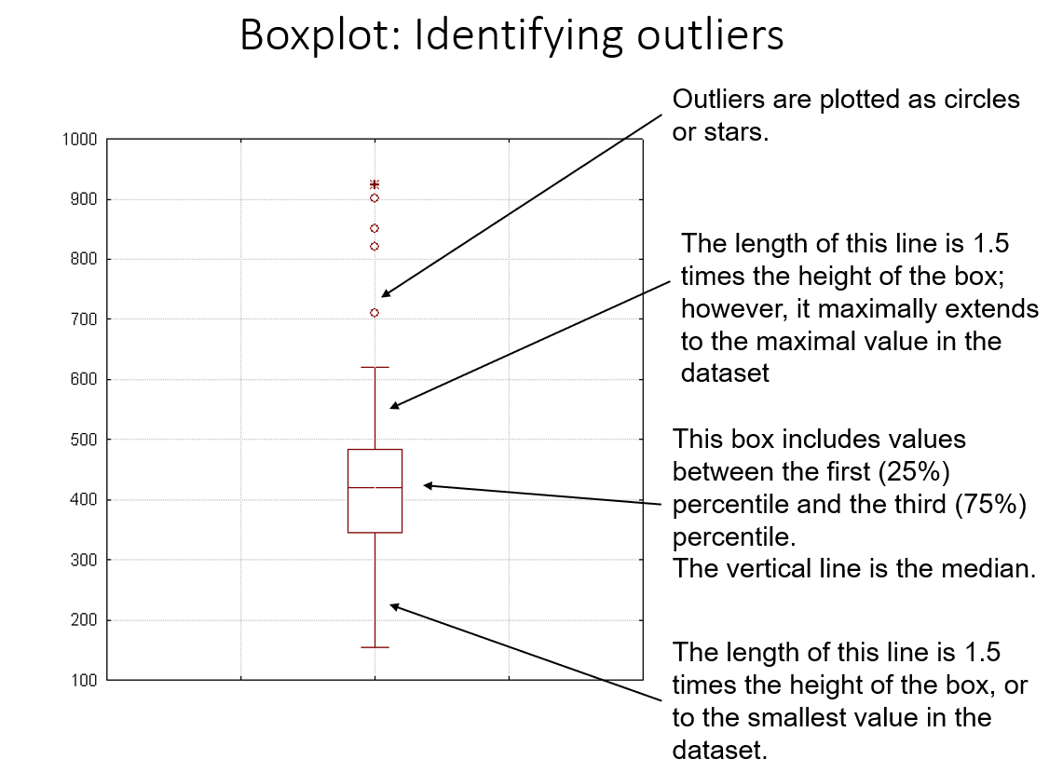
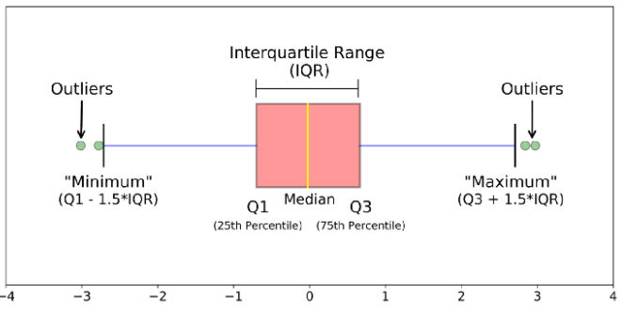
Boxplot
A box plot is used to illustrate the distribution, spread, and skewness (skewness) of numerical data through the display of quartiles.
Sources: https://en.wikipedia.org/wiki/Box_plot
and https://pandas.pydata.org/docs/reference/api/pandas.DataFrame.boxplot.html

Slide 11
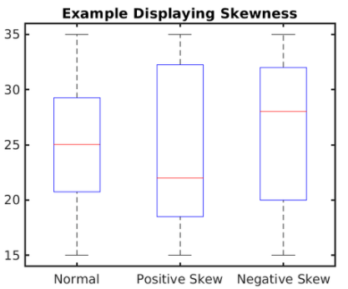
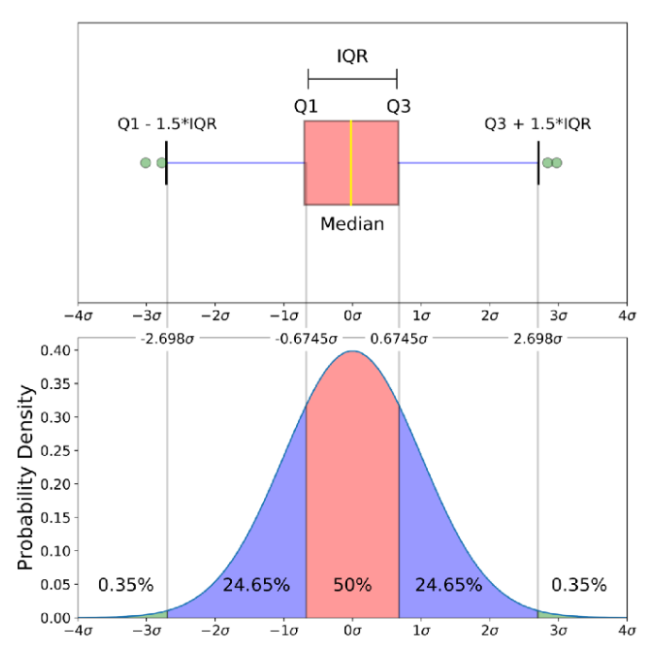
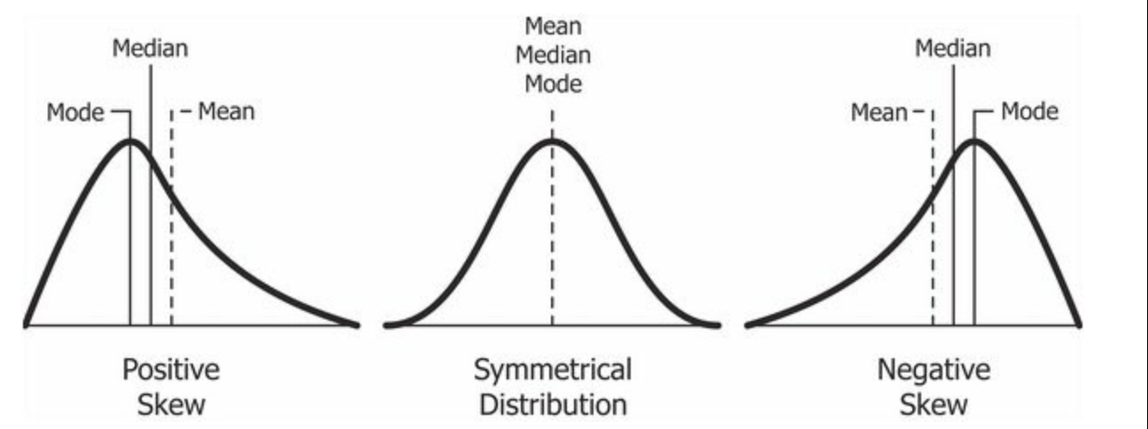
Boxplot On A Normal Distribution
Positive = right
Negative = left

Slide 12
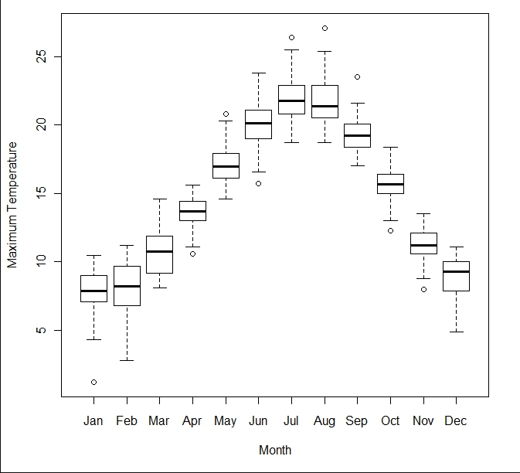
Boxplot Comparison

Slide 13
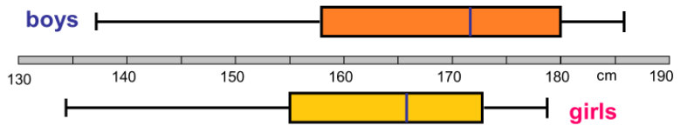
True or False?
Girls are on average taller?
Girls have a higher spread?
The shortest person is a girl?
The tallest person is a boy?
Both data sets are left skewd?
The average height of boys is 172 cm?
Half of the girls are between 155 and 170 cm?
The avg. height of boys is less than the median height?
Half of the boys are less than 172 cm?
Half the girls are taller than 165 cm?
¾ of the girls are taller than 155 cm?
¾ of the boys are lower than 180 cm?
The population displayed is ethnic Danish?

Slide 14
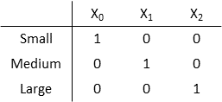
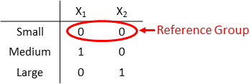
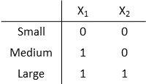
Dummy Variables
Step 1: Select Data Step 2: Preprocess Data Step 3: Transform Data
Also known as One-Hot Encoding!
Transforming categorical attribute to numerical attribute
Each attribute will have value either 0 or 1
Full Dummy Variables: Represent n categories using n dummy variables, one variable for each level
Dummy Variables with Reference Group: Represent
the categorical variable with n categories using n-1
dummy variables
Dummy Variables for Ordered Categorical Variable with Reference Group: Assume mathematical
ordering Small < Medium < Large. To indicate the
ordering, use more 1s for higher categories
https://de.mathworks.com/help/stats/dummy-indicator-variables.html

Slide 15
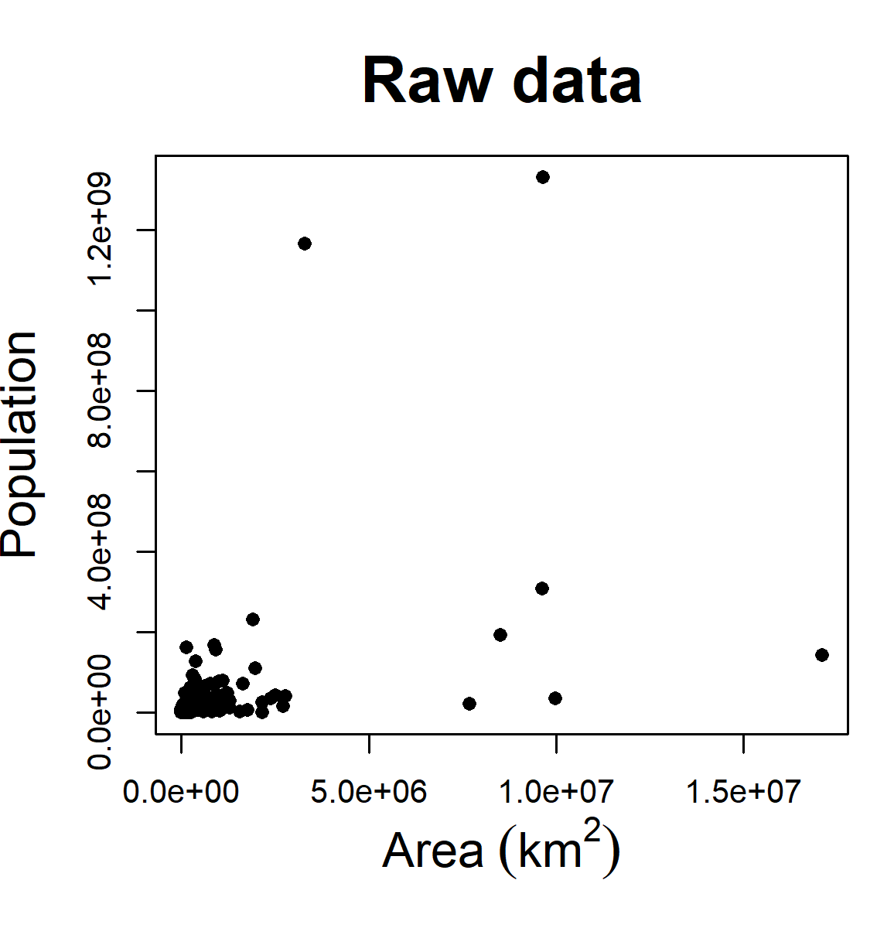
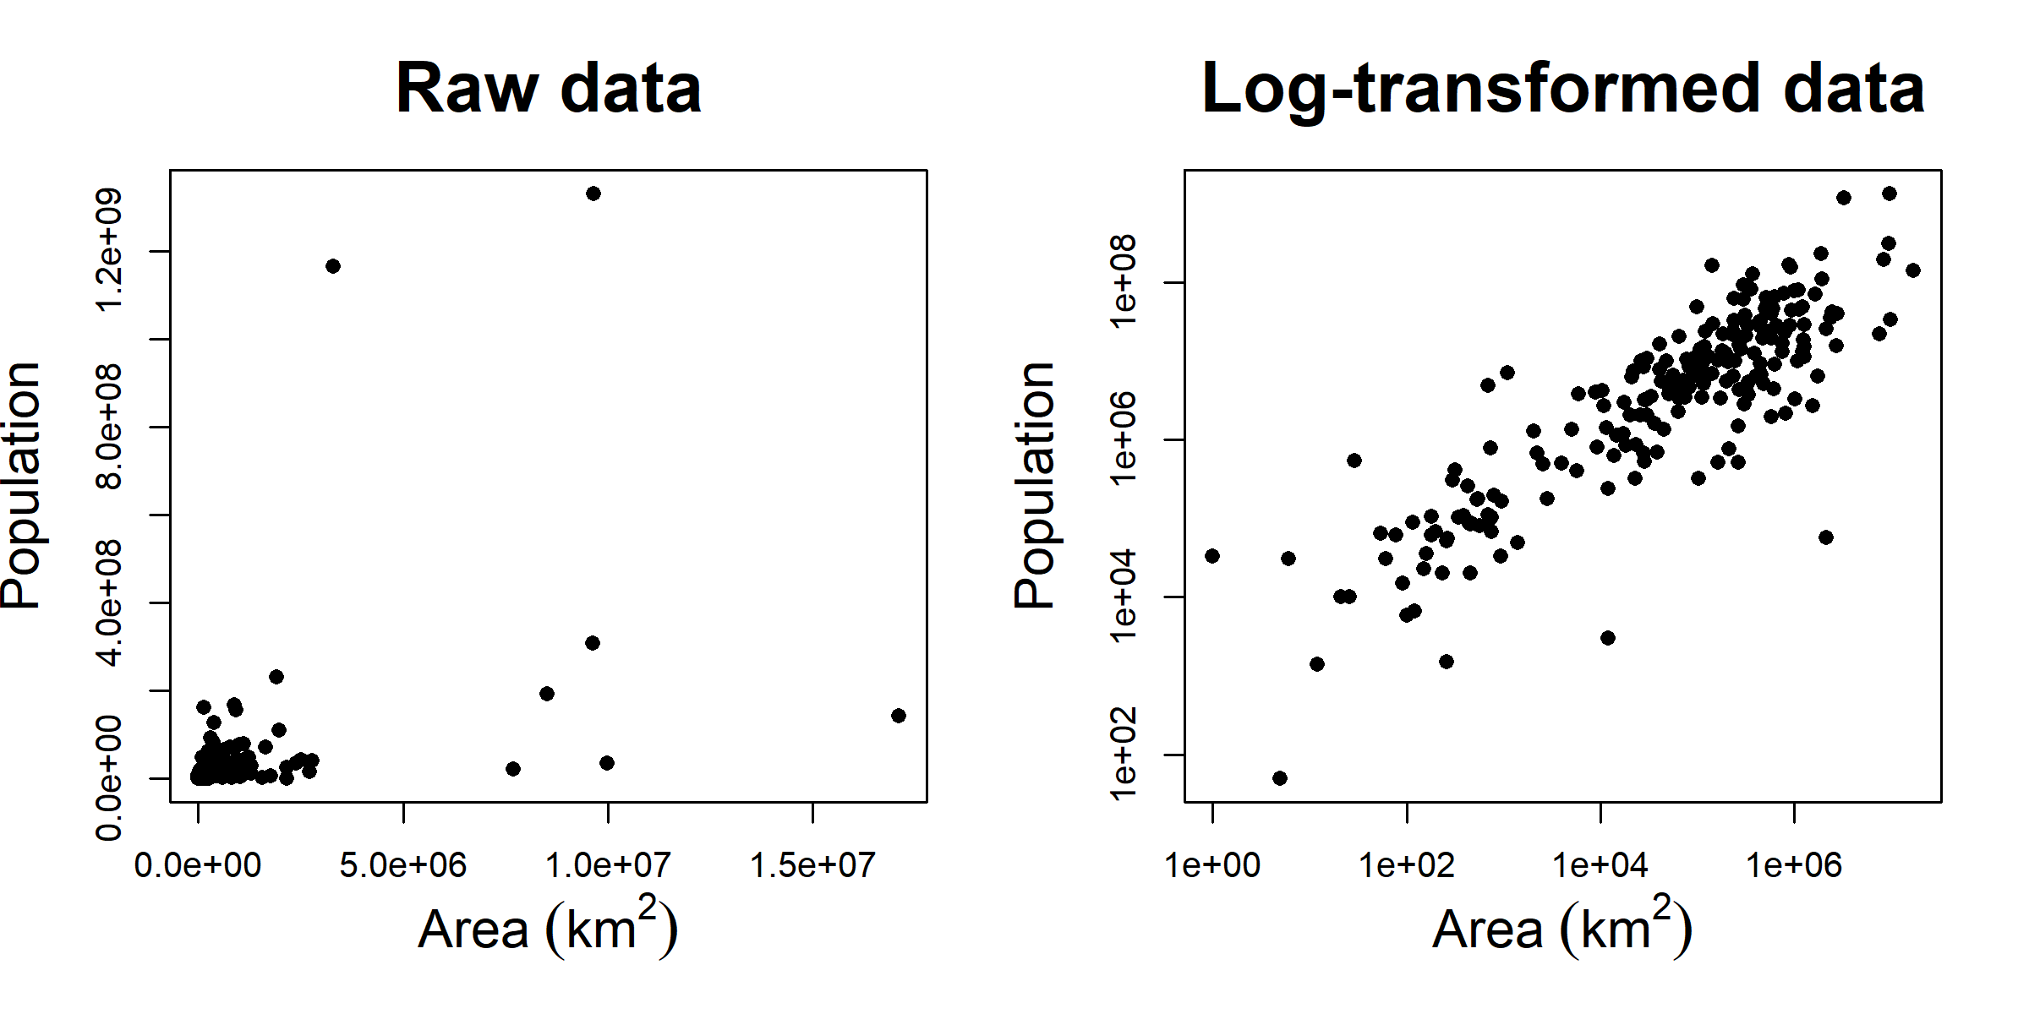
Transformed Attributes
Step 1: Select Data Step 2: Preprocess Data Step 3: Transform Data
Data transformation changes relative differences among individual values
Types of transformation:
¡ Linear: By adding constant or multiplying by constant
¡ Non-linear: log-transformation, square-root transformation etc.
https://www.davidzeleny.net/anadat-r/doku.php/en:data_preparation

Slide 16
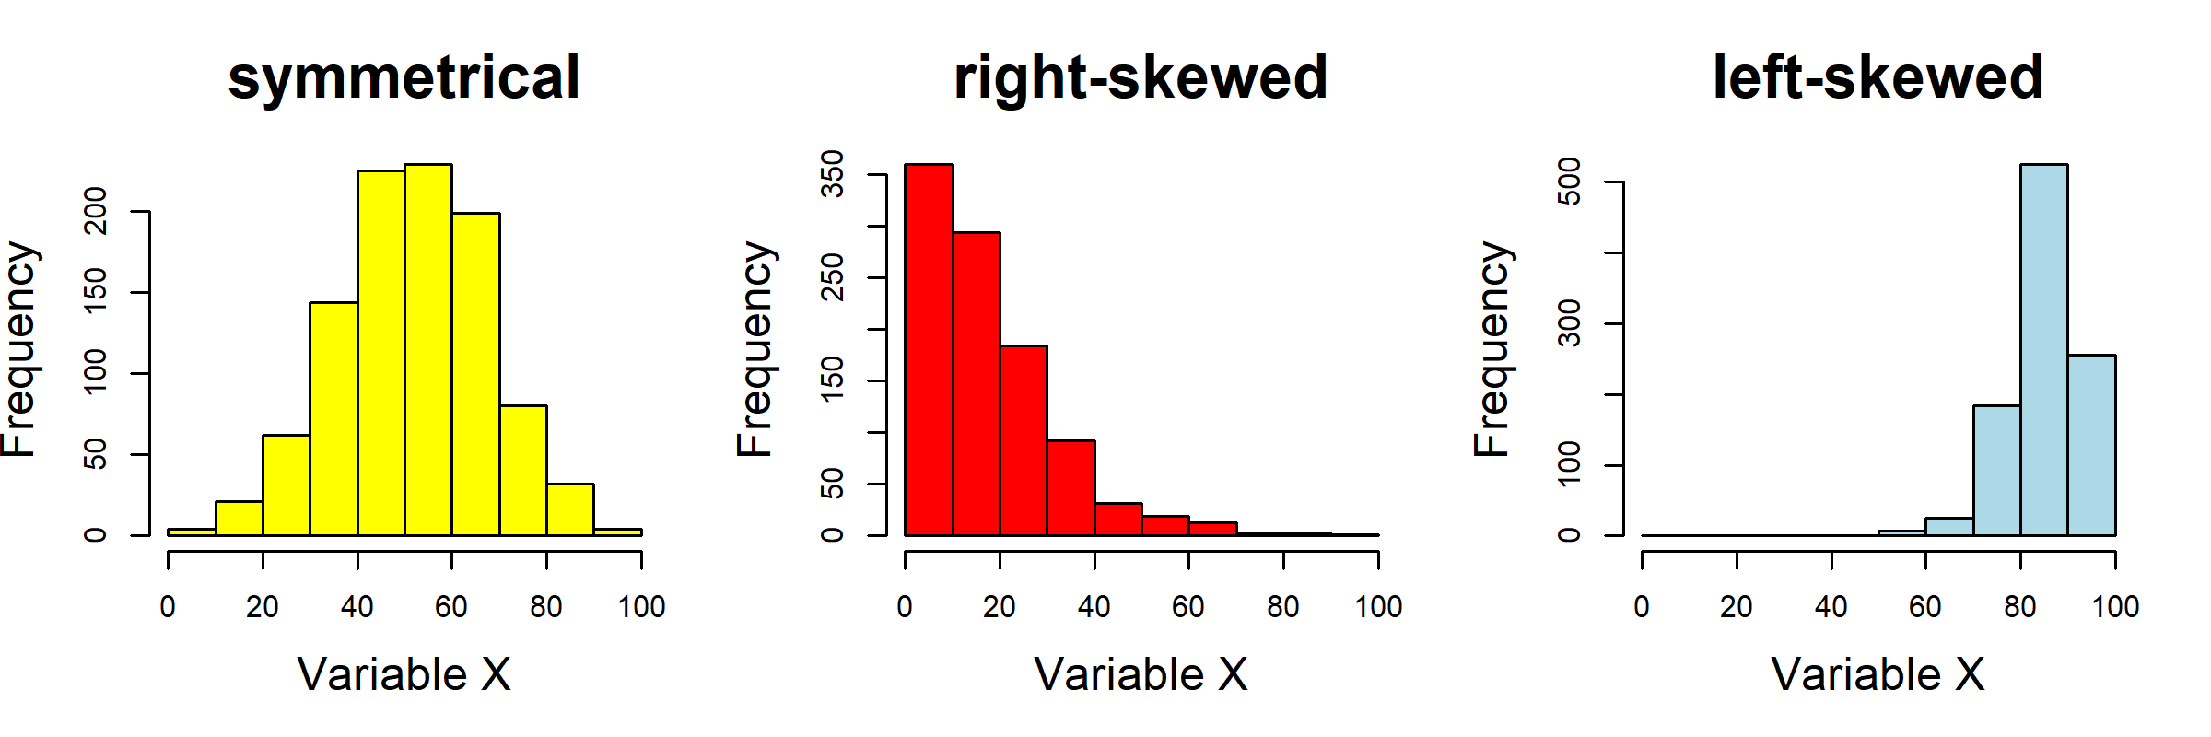
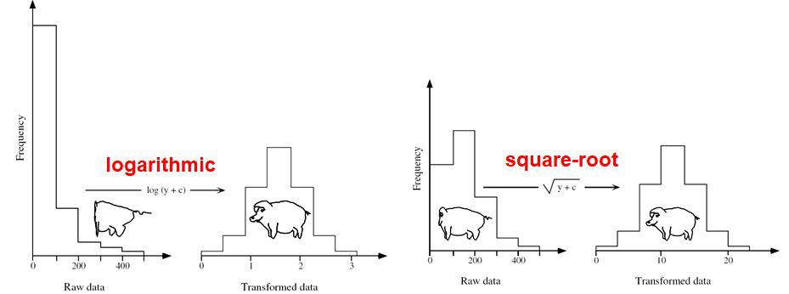
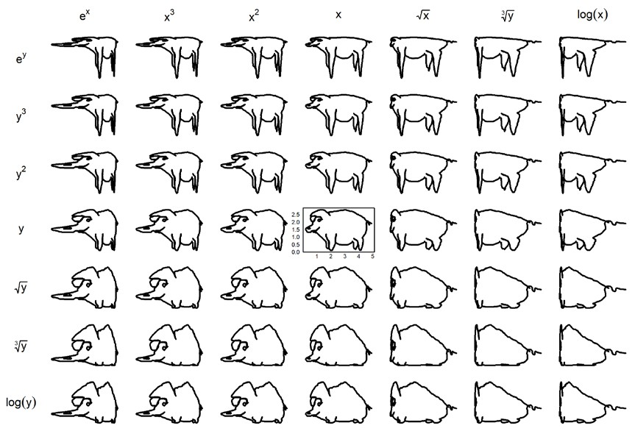
Transformed Attributes Box-Cox
Step 1: Select Data Step 2: Preprocess Data Step 3: Transform Data
log transformation is suitable for strongly right-skewed data, sqrt transformation is suitable for slightly right-skewed data
Preprocessing and Feature Engineering
Data Management for Digital Health, Winter 2019
14
https://www.davidzeleny.net/anadat-r/doku.php/en:data_preparation

Slide 17
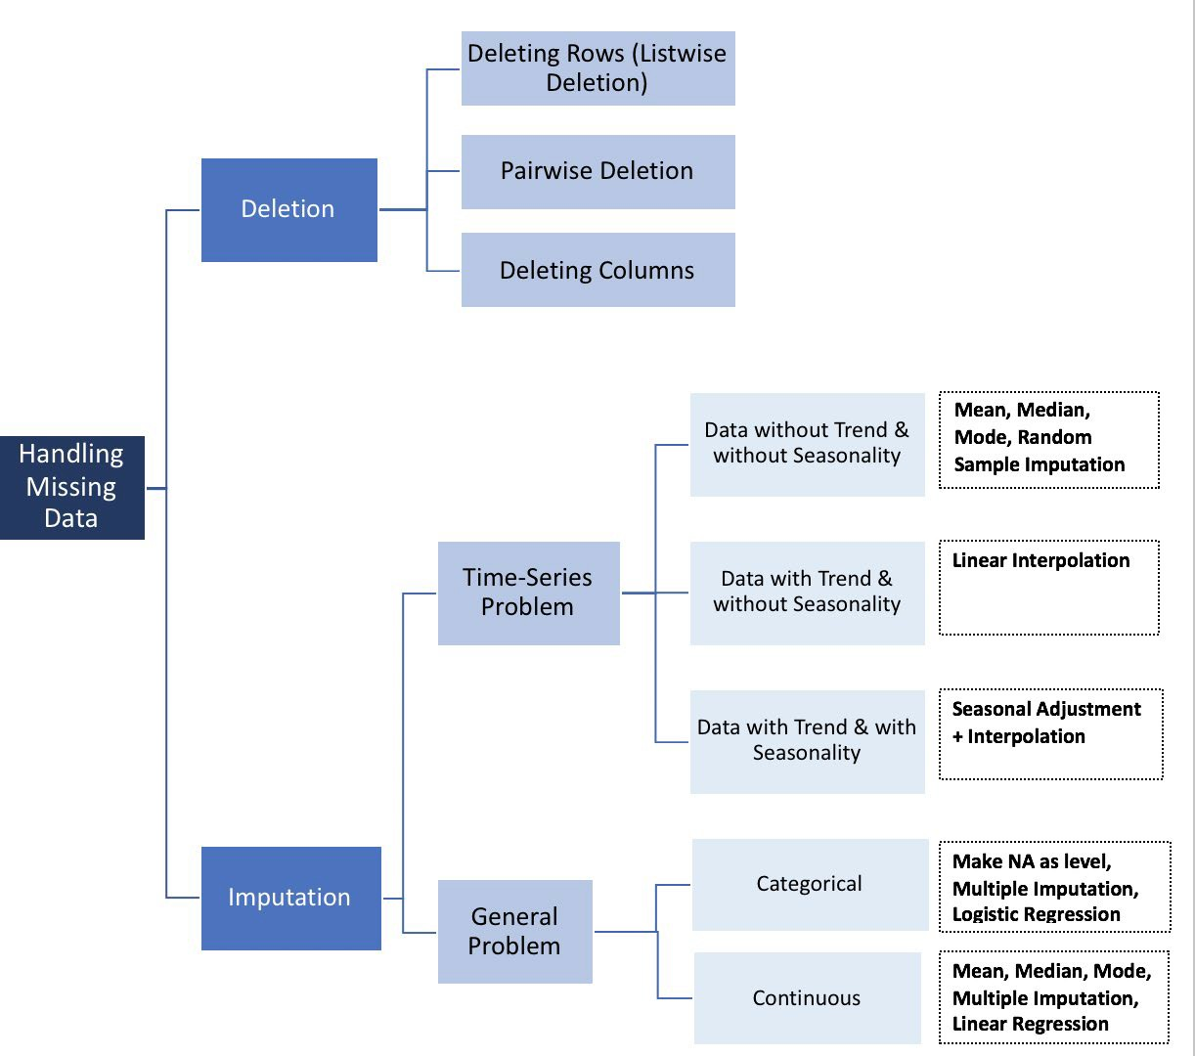
How to Handle Missing Data
Step 1: Select Data Step 2: Preprocess Data Step 3: Transform Data
There is NO good way to deal with missing data!
Different solutions for data imputation depending on the kind of problem — Time series Analysis, ML, Regression etc.
No general solution
https://towardsdatascience.com/how-to-handle-missing-data-8646b18db0d4

Slide 18
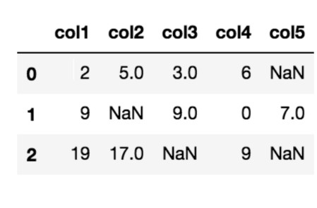
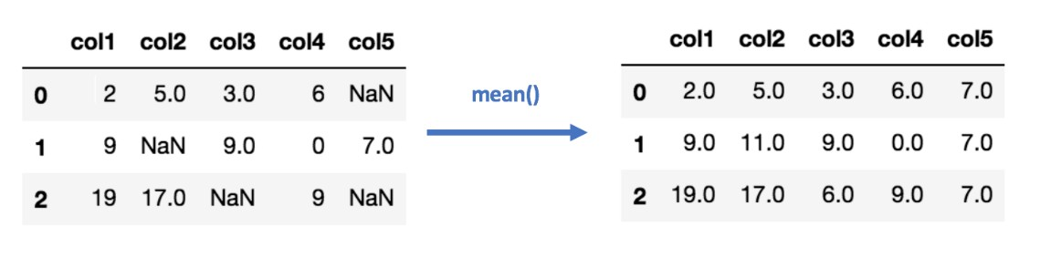
Data Imputation (Mean/Median) Values
Step 1: Select Data Step 2: Preprocess Data Step 3: Transform Data
Calculating the mean/median of the non-missing values in a column
Pros | Cons
Easy and fast | Doesn’t factor the correlations between features. It only works on the column level
Works well with small numerical datasets | Will give poor results on encoded categorical features (do NOT use it on categorical features)
 | Not very accurate
 | Doesn’t account for the uncertainty in the imputations

Slide 19
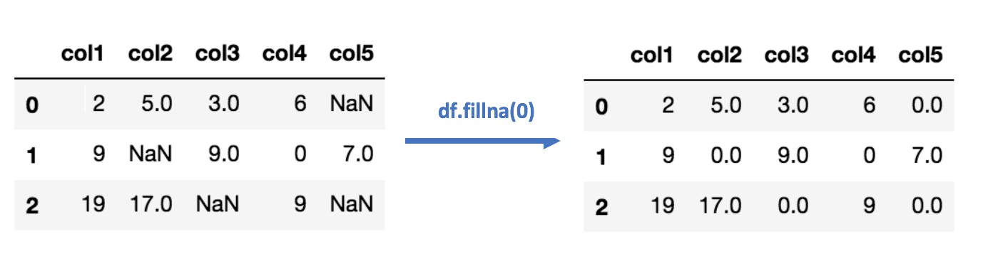
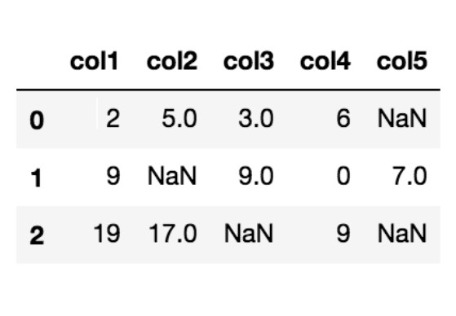
Data Imputation
(Most Frequent) or (Zero/Constant) Values
Step 1: Select Data Step 2: Preprocess Data Step 3: Transform Data
Most Frequent statistical strategy to impute missing values
Replacing missing data with the most frequent values within each column
Pros | Cons
Works well with categorical features | It also doesn’t factor the correlations between features
 | It can introduce bias in the data
Zero or Constant imputation replaces the missing values with either zero or any constant value you specify

Slide 20
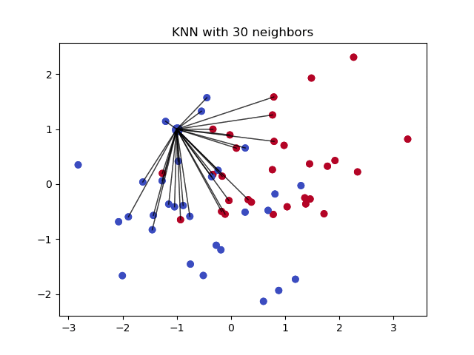
Data Imputation k-NN
Step 1: Select Data Step 2: Preprocess Data Step 3: Transform Data
Algorithm uses ‘feature similarity’ to predict the values of any new data points
New point is assigned a value based on how closely it resembles the points in the training set
Pros | Cons
Can be much more accurate than the mean, median or most frequent imputation methods (It depends on the dataset) | Computationally expensive. KNN works by storing the whole training dataset in memory
 | K-NN is quite sensitive to outliers in the data (unlike SVM)

Slide 21
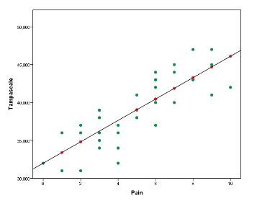
Data Imputation Regression
Step 1: Select Data Step 2: Preprocess Data Step 3: Transform Data
With regression imputation the information of other variables is used to predict the missing values in a variable by using a regression model.
Commonly, first the regression model is estimated in the observed data and subsequently using the regression weights the missing values are predicted and replaced.
Pros | Cons
Can be much more accurate than the mean, median or most frequent imputation methods (It depends on the dataset) | Computationally expensive. Regression works by storing the whole training dataset in memory
 | Regression is also quite sensitive to outliers in the data

Slide 22
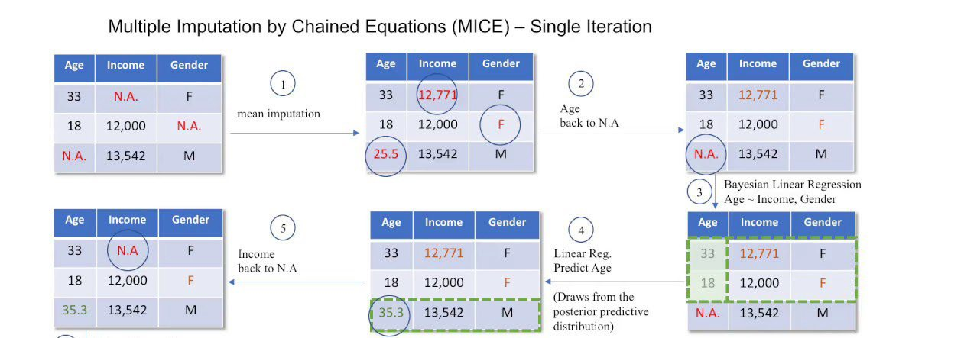
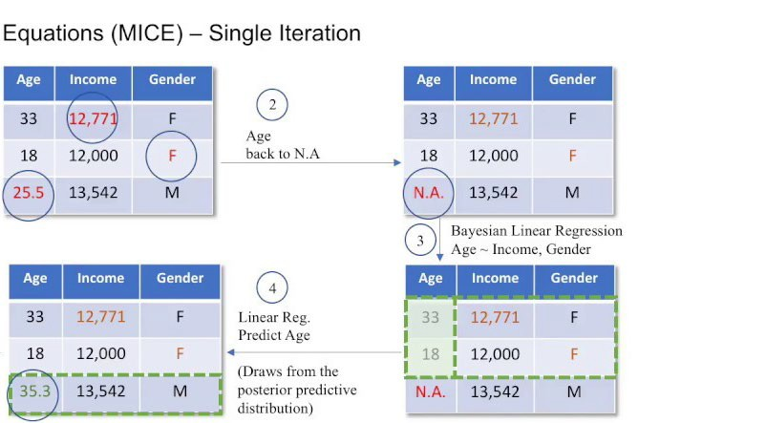
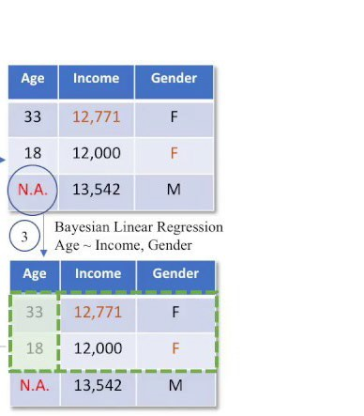
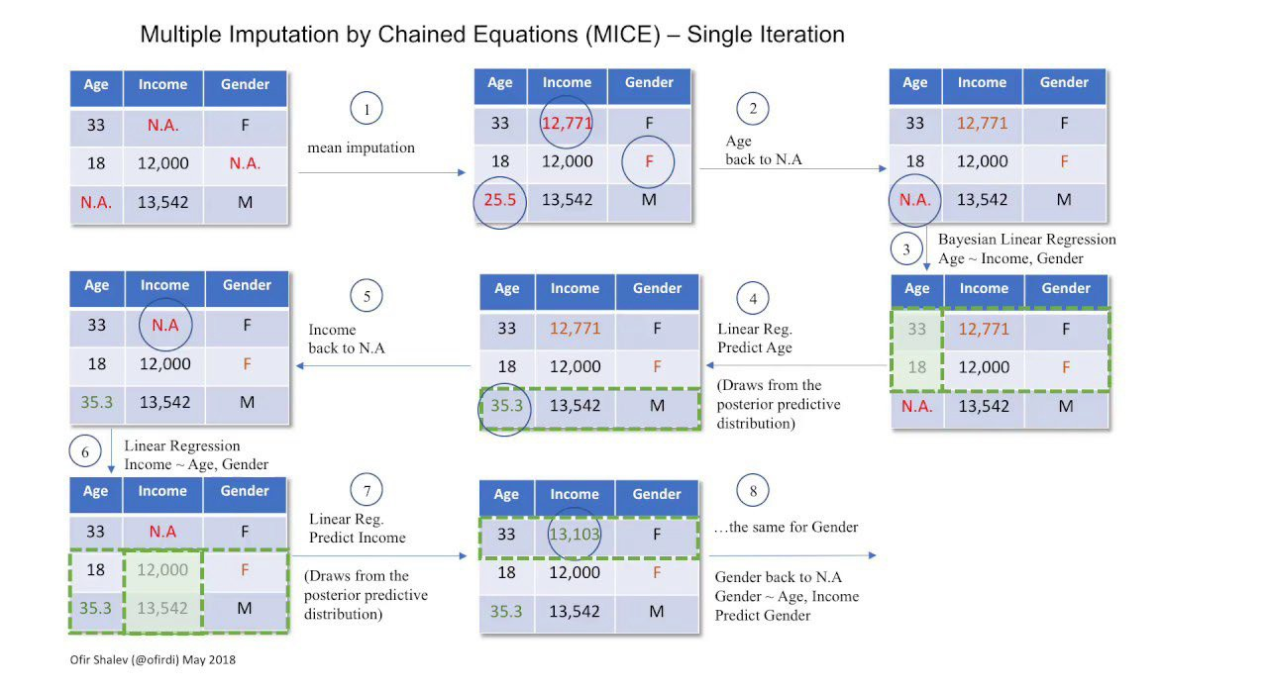
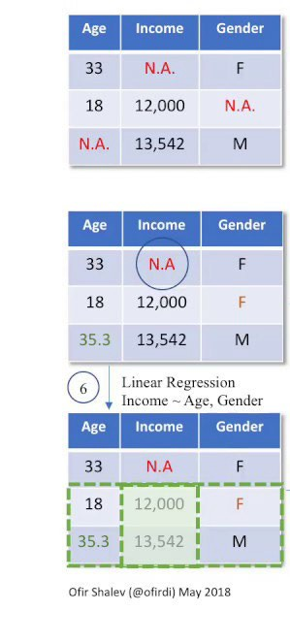
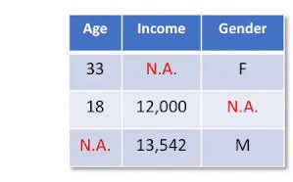
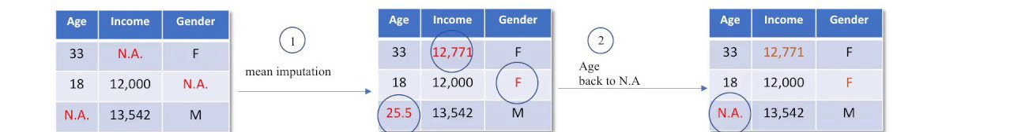
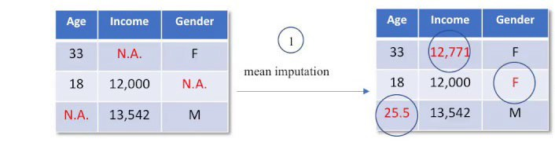
Data Imputation Multivariate Imputation
Step 1: Select Data Step 2: Preprocess Data Step 3: Transform Data
Filling the missing data multiple times
Multiple Imputations (MIs) are much better than a single imputation as it measures the uncertainty of the missing values in a better way
Chained equations approach is also very flexible and can handle different variables of different data types
https://www.youtube.com/watch?v=zX-pacwVyvU

Slide 23
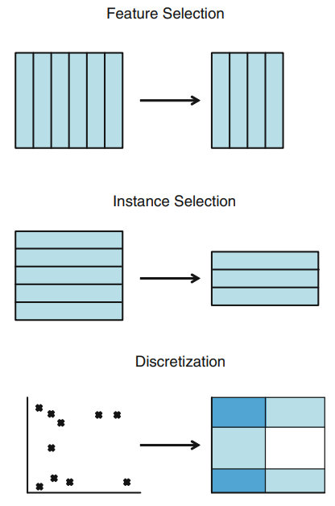
Data Reduction
Step 1: Select Data Step 2: Preprocess Data Step 3: Transform Data
How do I reduce the dimensionality of data? → Feature Selection (FS)
How do I remove redundant and/or conflictive examples? → Instance Selection (IS) How do I simplify the domain of an attribute? → Discretization
How do I fill in gaps in data? → Feature Extraction and/or Instance Generation
Preprocessing and Feature Engineering
Data Management for Digital Health, Winter 2019
20

Slide 24
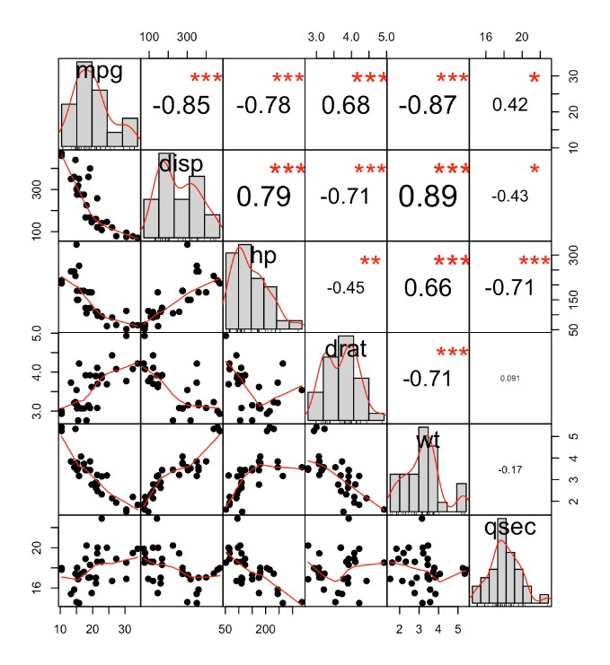
Correlation
Step 1: Select Data Step 2: Preprocess Data Step 3: Transform Data
Way to understand the relationship between multiple variables and attributes in your dataset
Using Correlation, you can get some insights such as:
¡ One or multiple attributes depend on another
¡ One or multiple attributes are associated with other attributes
Can help in predicting one attribute from another (great way to impute missing values)
Can (sometimes) indicate the presence of a causal relationship
http://www.sthda.com/english/wiki/correlation-analyses-in-r

Slide 25
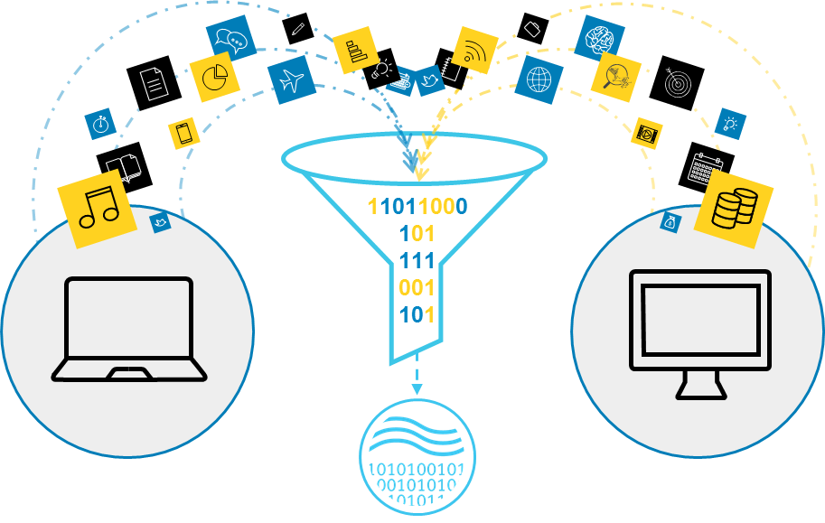
Transform Data
Step 1: Select Data Step 2: Preprocess Data Step 3: Transform Data
Scaling: The preprocessed data may contain attributes with a mixtures of scales for various quantities. Many machine learning methods like data attributes to have the same scale
Decomposition: There may be features that represent a complex concept that may be more useful to a machine learning method when split into the constituent parts
¡ Example → Date
Aggregation: There may be features that can be aggregated into a single feature
https://blog.dellemc.com/en-us/digital-transformation-just-got-easier-with-analytic- insights/

Slide 26

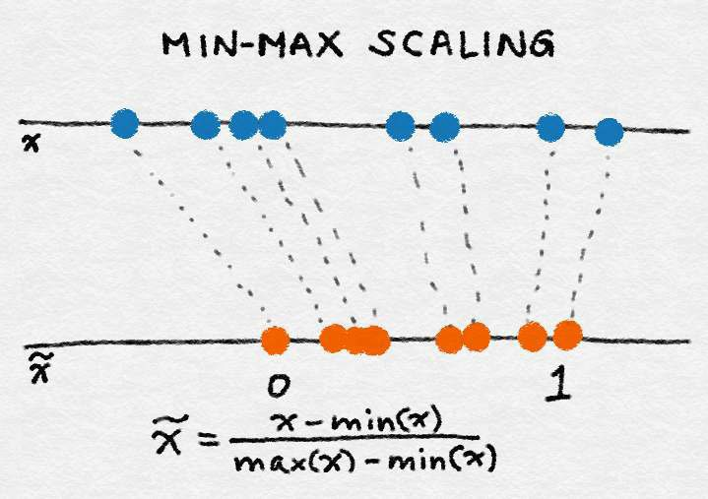
Min-Max Scaling
Step 1: Select Data Step 2: Preprocess Data Step 3: Transform Data
Let x be an individual feature value (i.e., a value of the feature in some data point) and let min(x) and max(x), respectively, be the minimum and maximum values of this feature over the entire dataset
Min-max scaling squeezes (or stretches) all feature values to be within the range of [0, 1]
Feature Engineering for Machine Learning Principles and Techniques for Data Scientists Alice Zheng and Amanda Casari, O’Reilly, 2018

Slide 27

Mean normalization
Step 1: Select Data Step 2: Preprocess Data Step 3: Transform Data
where x is an original value, x' is the normalized value. There is another form of the means normalization which divides by the standard deviation which is also called standardization.

Slide 28
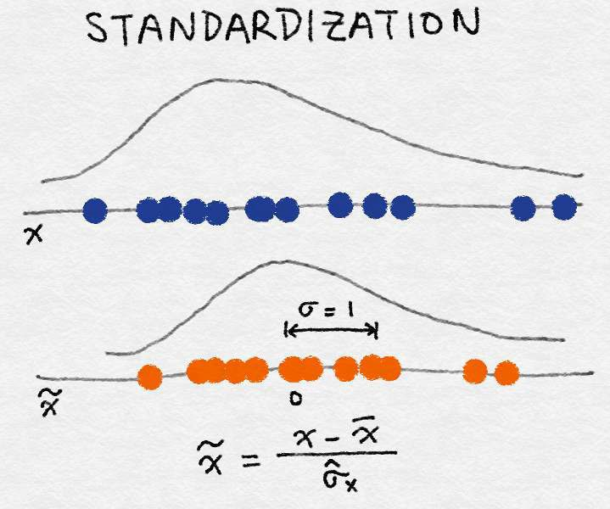

Standardization (Variance Scaling)
Step 1: Select Data Step 2: Preprocess Data Step 3: Transform Data
It subtracts off the mean of the feature (over all data points) and divides by the variance
It can also be called variance scaling
resulting scaled feature has a mean of 0 and a variance of 1
If the original feature has a Gaussian distribution, then the scaled feature does too
Feature Engineering for Machine Learning Principles and Techniques for Data Scientists Alice Zheng and Amanda Casari, O’Reilly, 2018

Slide 29
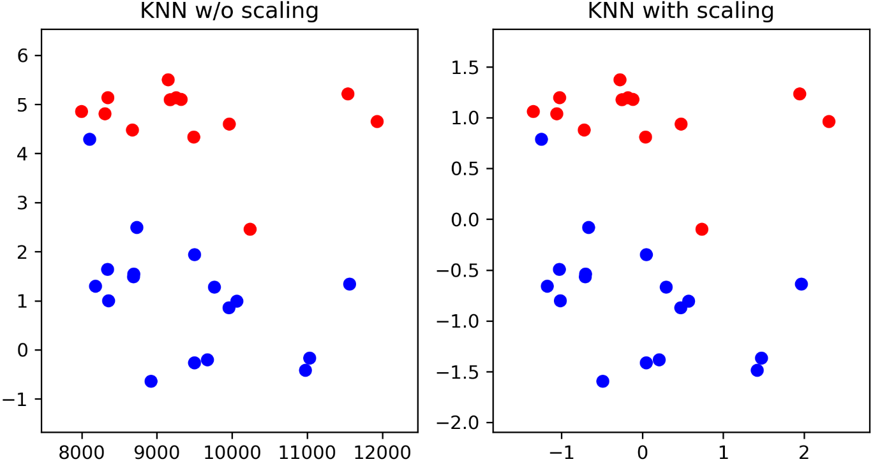
Why Scaling?
Step 1: Select Data Step 2: Preprocess Data Step 3: Transform Data
https://blog.dellemc.com/en-us/digital-transformation-just-got-easier-with-analytic- insights/

Slide 30
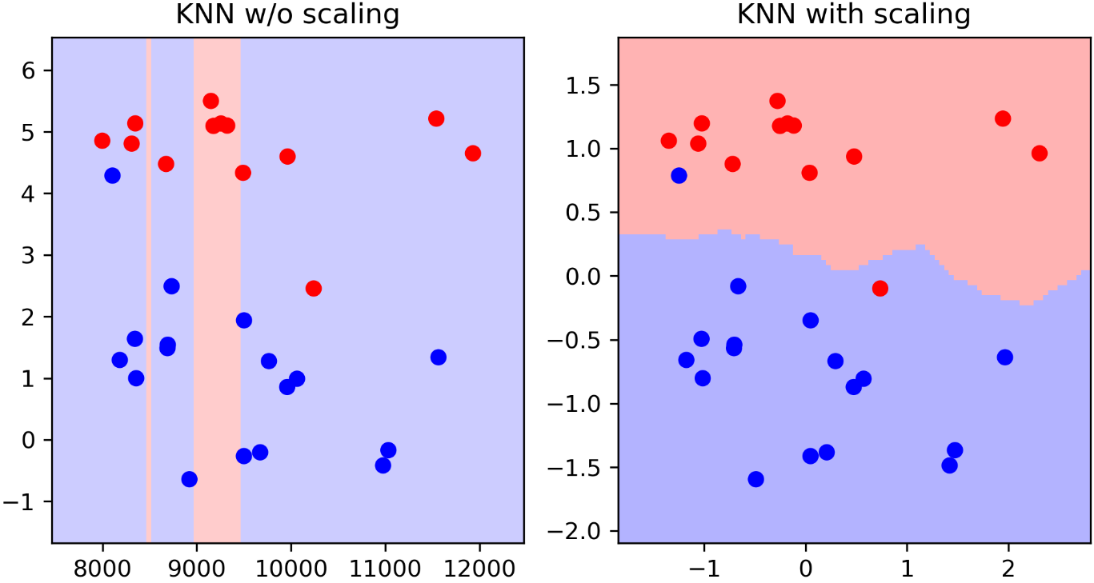
Why Scaling?
Step 1: Select Data Step 2: Preprocess Data Step 3: Transform Data
https://blog.dellemc.com/en-us/digital-transformation-just-got-easier-with-analytic- insights/

Slide 31
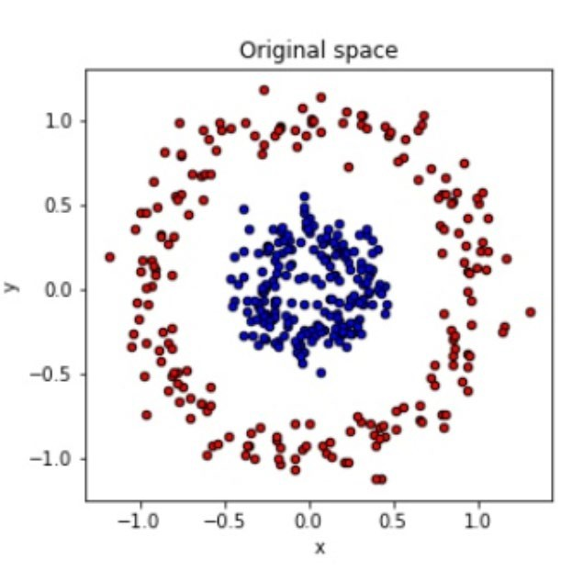
Feature Engineering
Example: Coordinate Transformation
Step 1: Select Data Step 2: Preprocess Data Step 3: Transform Data
Not possible to seperate using linear classifier

Slide 32
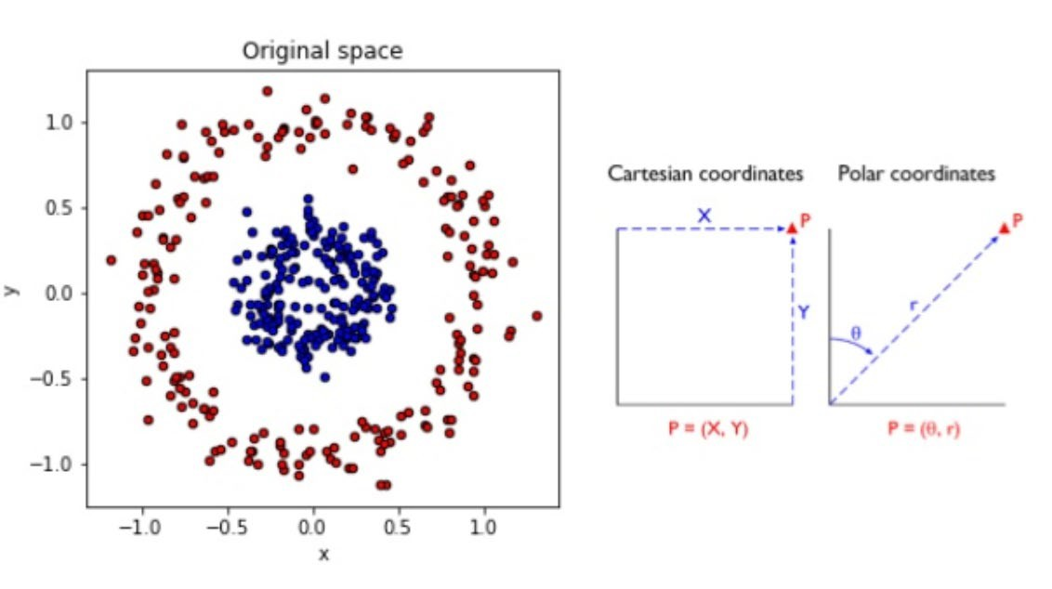
Feature Engineering
Example: Coordinate Transformation
Step 1: Select Data Step 2: Preprocess Data Step 3: Transform Data
What if you use polar Coordinates instead?

Slide 33
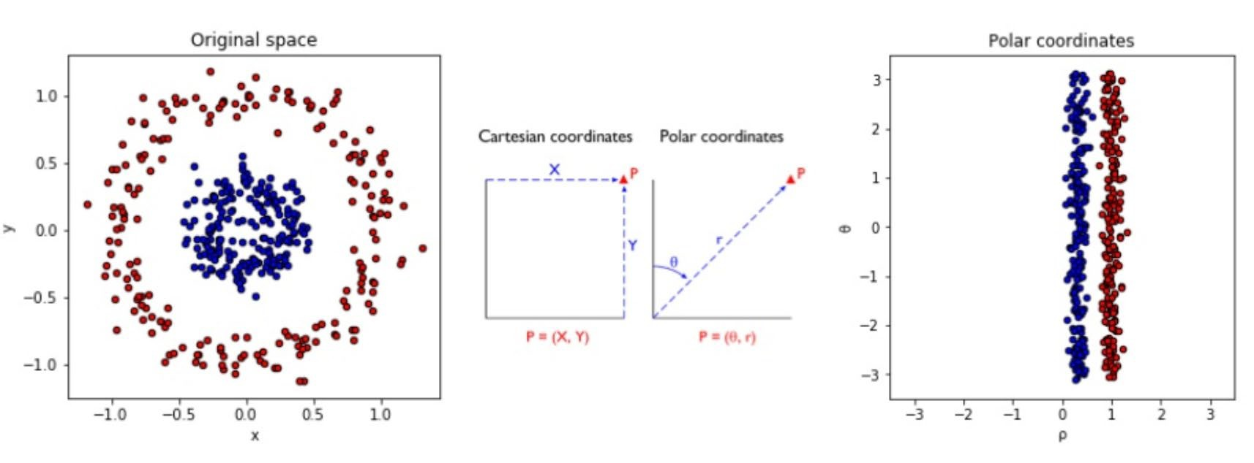
Feature Engineering
Example: Coordinate Transformation
Step 1: Select Data Step 2: Preprocess Data Step 3: Transform Data

Slide 34
Aspects of Feature Engineering
Step 1: Select Data Step 2: Preprocess Data Step 3: Transform Data
Feature Engineering
Feature Selection | Most useful and relevant features are selected from the available data
Feature Extraction | Existing features are combined to develop more useful ones
Feature Addition | New features are created by gathering new data
Feature Filtering | Filter out irrelevant features to make the modeling step easy

Slide 35
Selection
Filtering
Purpose: To select a subset of the most relevant features from the original set of features.
Why: Reduces overfitting, improves accuracy, and reduces training time.
Methods*:
Wrapper methods: Use a predictive model to evaluate the usefulness of features. Examples include forward selection, backward elimination, and recursive feature elimination.
Filter methods: Rank features based on statistical measures and select the top features. Examples include correlation coefficient, chi-squared test, and mutual information.
Embedded methods: Algorithms that have built-in feature selection methods. Examples include LASSO and decision trees.
Outcome: A reduced set of features that are deemed most important for the predictive modeling task.
Purpose: To remove features based on certain criteria without necessarily considering the target variable.
Why: To remove redundant or irrelevant features, which can be noise in the data.
Methods*:
Variance threshold: Removing features with low variance.
Correlation threshold: Removing features that are highly correlated with other features.
Missing values threshold: Removing features with a high percentage of missing values.
Outcome: A reduced set of features that meet certain quality criteria.
* https://www.analyticsvidhya.com/blog/2016/12/introduction-to-feature-selection-methods-with-an-example-or-how-to-select-the-right-variables/

